Slide 1
What are the best risks for auto insurance?
For the goal of keeping the loss ratio low
By Renee Payne | November 2025

Slide 2
Overview
In this presentation, I will look at seven different characteristics and see which ones have the lowest claim totals. This will give an idea of what kind of policyholders to market to.
Data used is AutoInsurance.csv from Kaggle.com.
Notes:
In other words, the best risks for keeping loss ratio low.

Slide 3
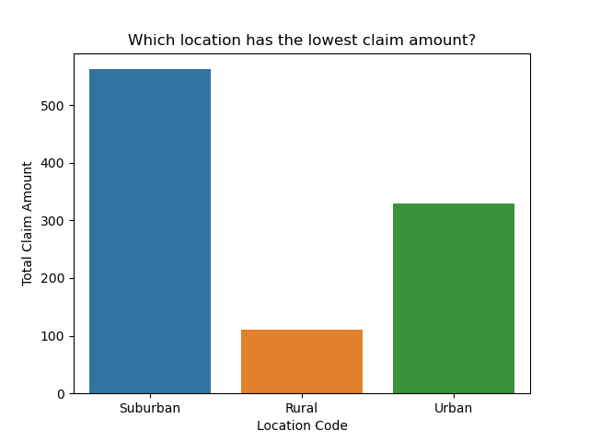
Location of policyholder
Notes:
Rural customers have the lowest claim amounts. Suburban has the highest.

Slide 4
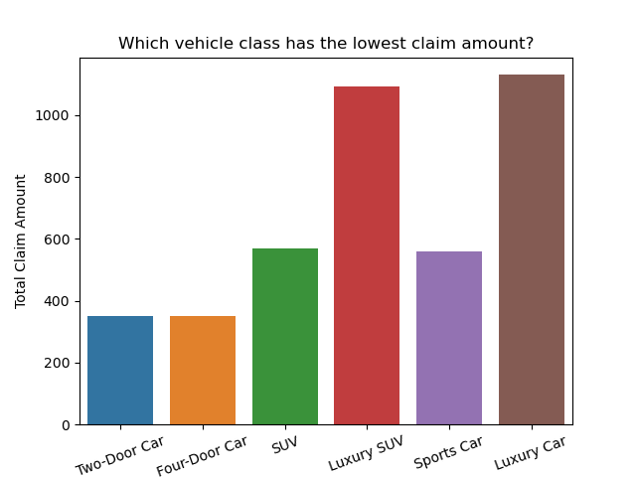
Class of vehicle
Notes:
Non-luxury vehicles have much lower claim amounts than luxury vehicles do.

Slide 5
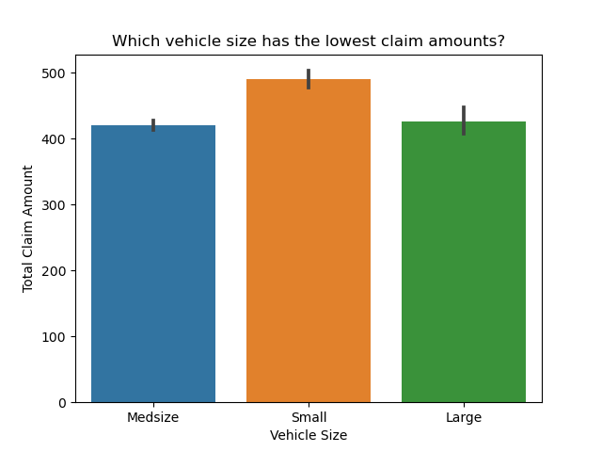
Size of vehicle
Notes:
Small vehicles have the highest claim amounts with medium and large vehicles approximately the same.

Slide 6
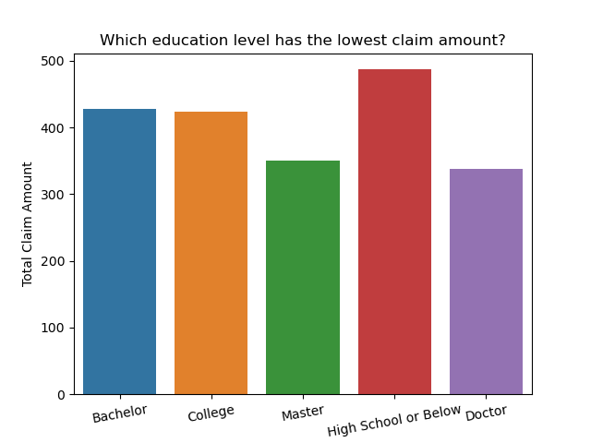
Education level of policyholder
Notes:
High school or below have the highest claim amounts with master and doctor at the lowest. The more education they have, the lower their claim amount.

Slide 7
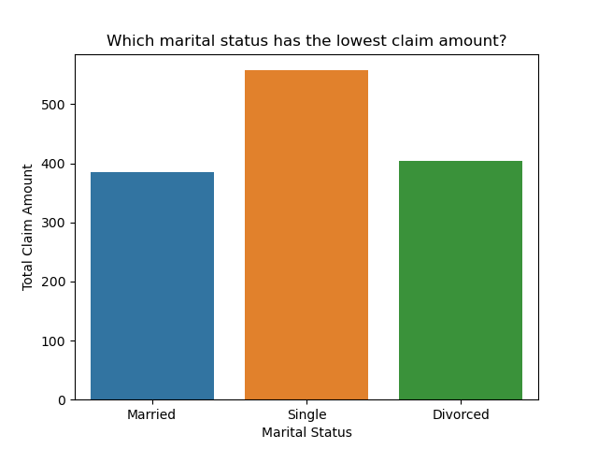
Marital status of policyholder
Notes:
Single people have the highest claim amount with married and divorced about the same.

Slide 8
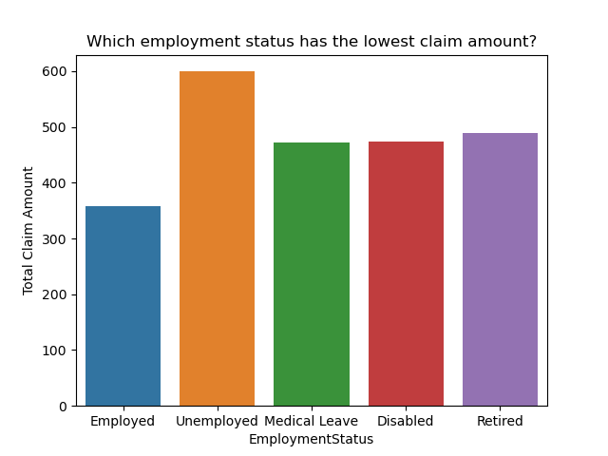
Employment status of policyholder
Notes:
Employed policyholders have the lowest claim amount. Medical leave and disabled are about the same.

Slide 9
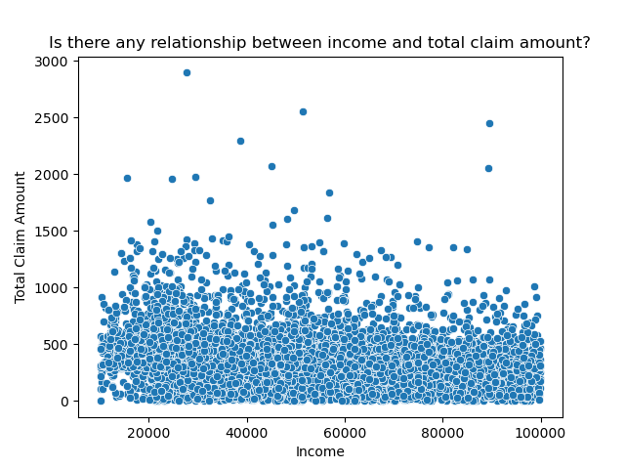
income
Notes:
Income makes no difference. Whether it is $10,000 or $100,000, they have approximately the same claim amounts.

Slide 10
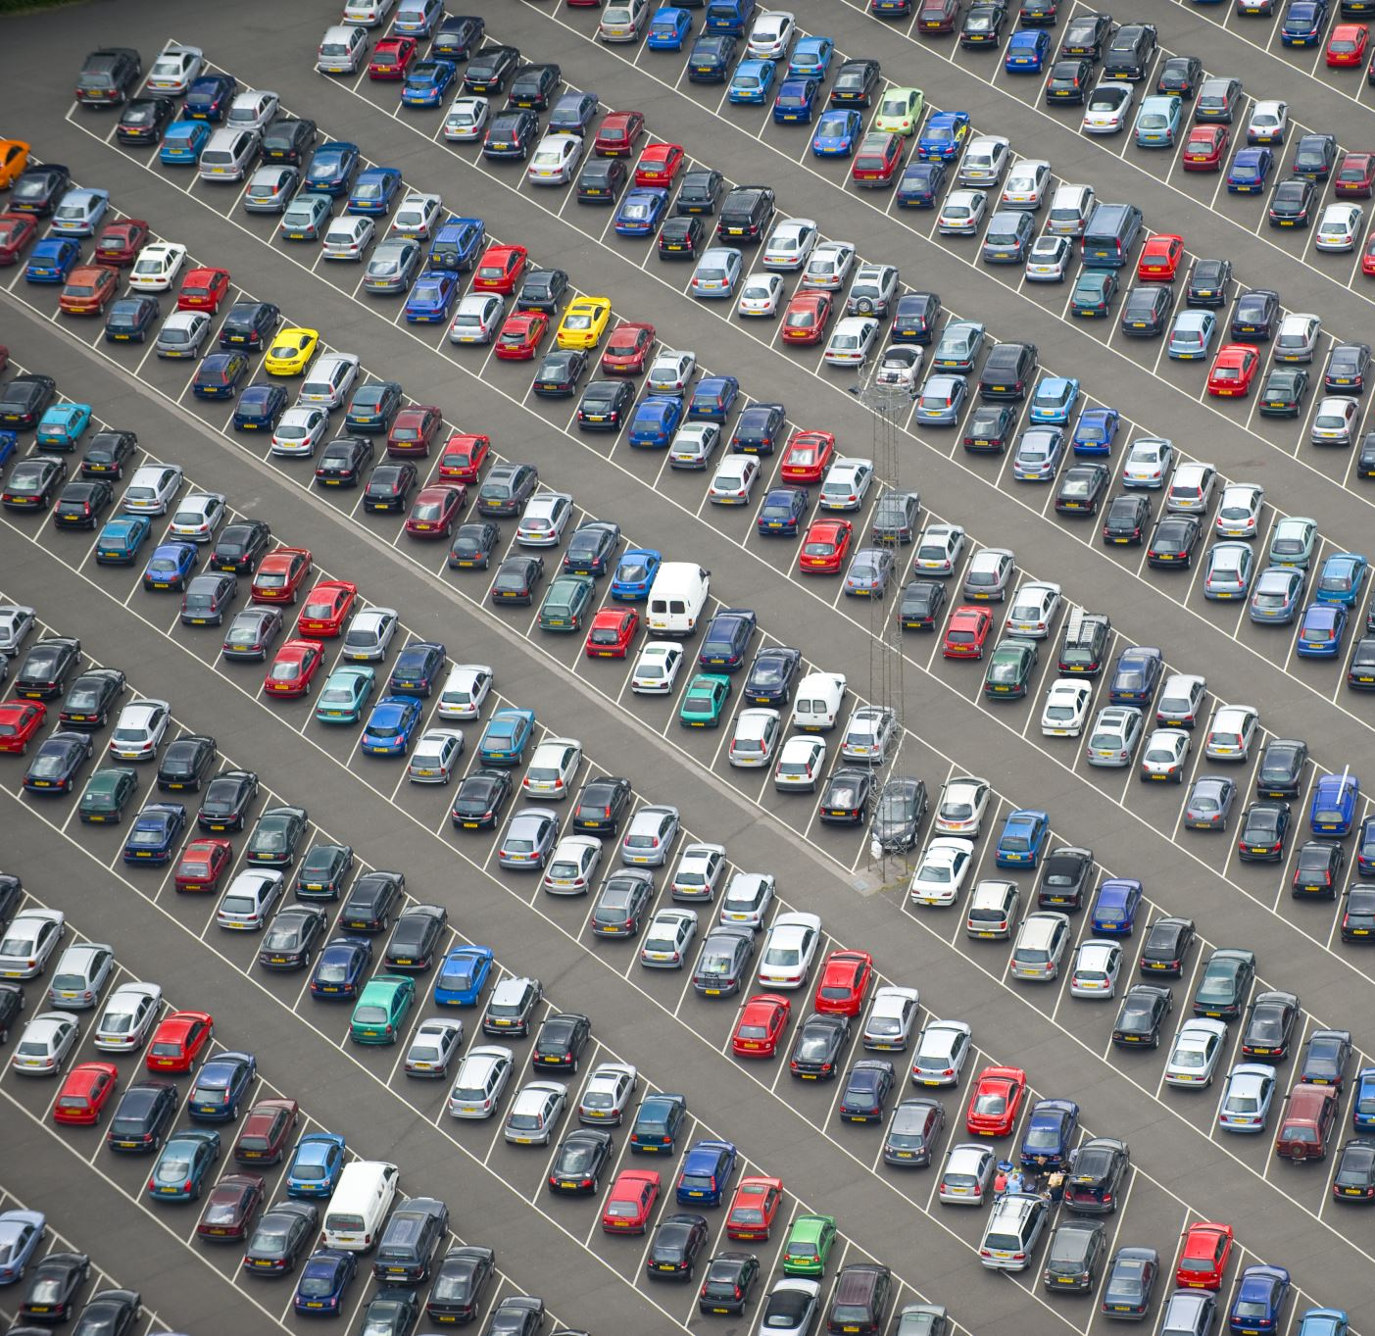
Conclusion
The best risks are:
Rural policyholders
Non-luxury vehicles especially sedans
Medium and large size vehicles
Policyholders with a masters or higher education level
Married or divorced policyholders
Policyholders who are employed

